Slide 1
The Python
Machinetalk Bindings
Alexander Rössler

Slide 2
Overview
Machinetalk
pymachinetalk
Applications
Outlook

Slide 3
Machinetalk

Slide 4
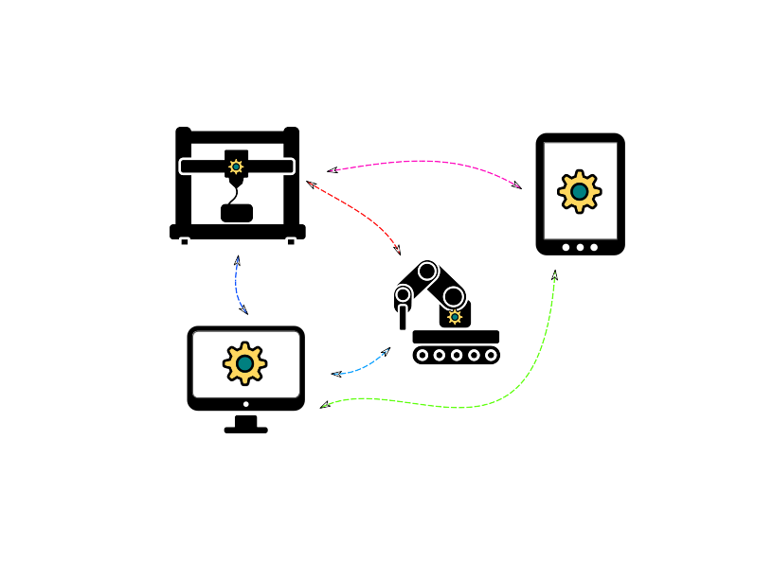
Machinetalk
Middleware
Interaction between RT and non-RT
Distributed setups
License abstraction

Slide 5

Launcher Service
launcher & launchercmd
mklauncher
Contact point
Lists configurations
Launches new instances

Slide 6
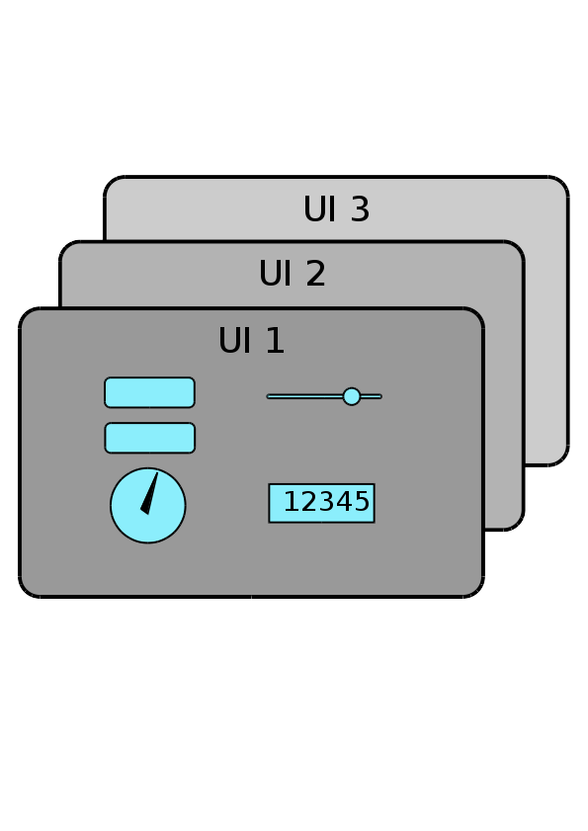
Config Service
config
configserver
Distributes Uis
Running configuration

Slide 7
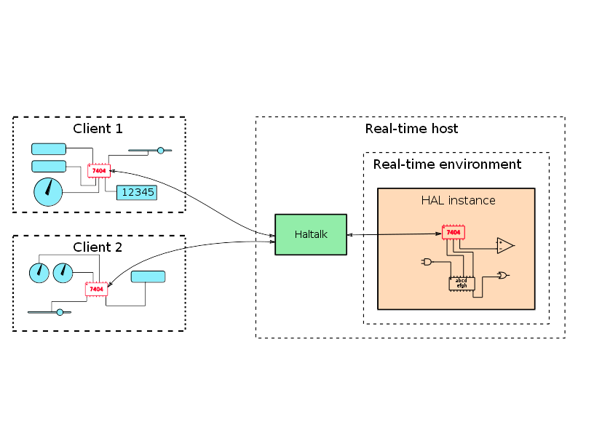
Halremote Service
halrcomp & halrcmd
haltalk
Remote API

Slide 8
Application Services
status, command, error, file, preview
mkwrapper
EMC interface

Slide 9
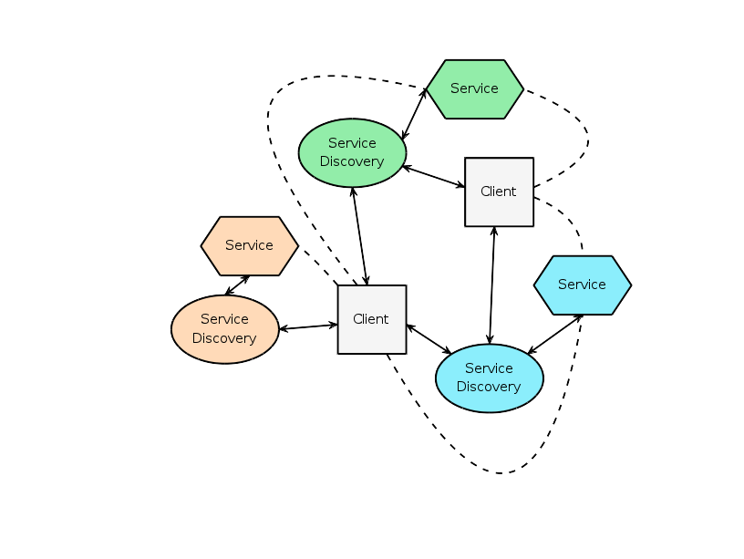
Service Discovery
MDNS/DNS-SD
.local
Auto configuration
Decentralized
Multicast
Unicast

Slide 10

Connection Flow
Search for launcher services
List instances

Slide 11
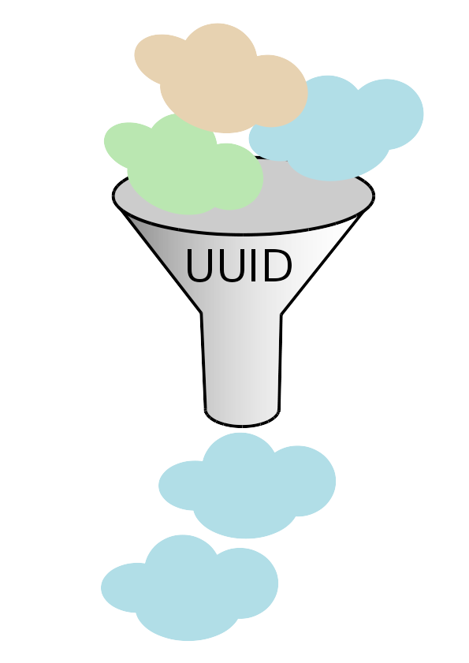
Connection Flow
Filter services
Look for config
  Start instance
Load UI
Connect other services

Slide 12
PyMachinetalk

Slide 13

Threading
Asynchronous
Synchronous
Locks and conditions

Slide 14
dns_sd
avahi & dbus
gobject
Service type
  _launcher._sub._machinekit._tcp
Callbacks

Slide 15
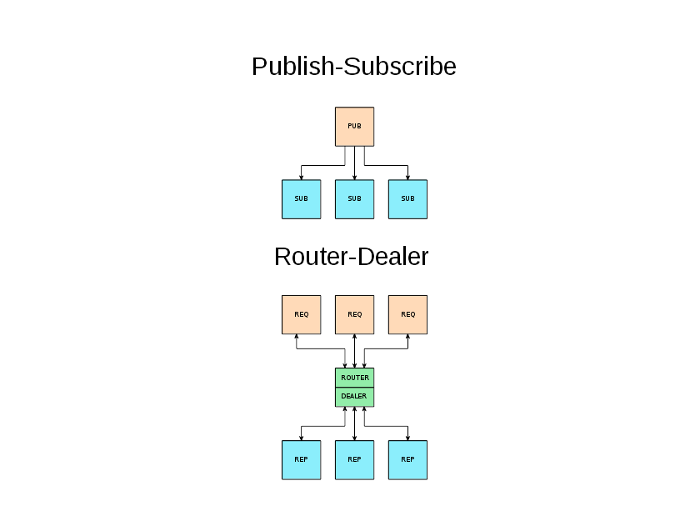
halremote
Canonical to HAL userland component
RemoteComponent
Pin

Slide 16
application
ApplicationStatus
ApplicationCommand
ApplicationError
ApplicationFile

Slide 17
Applications

Slide 18
Applications
Testing Machinetalk
Remoting HAL
CLIs and UIs
Distritbuted HAL setups
3rd party plugins

Slide 19
Outlook

Slide 20
Outlook
Launcher & config
Documentation
More examples
Unit tests for Machinetalk
…

Slide 21
More Information and Code
https://github.com/strahlex/pymachinetalk

Slide 22
Questions?

